Slide 1

Hotel Booking Cancellation Prediction
MLDM 364.2.1651
Professor Boaz Lerner
Dafna Meron, Oriel Perets
MLDM | Dafna Meron, Oriel Perets

Slide 2
Presentation Plan
Business Understanding
Data Understanding
Data Preparation
Modelling
Evaluation
Future Work
MLDM | Dafna Meron, Oriel Perets

Slide 3





Business Understanding
The hospitality industry – 4.1 T$ / year globally
Hotel industry – 35% or 1.5 T$ / year globally
Accurate demand management as an important pillar of success(source)
Major Players:
MLDM | Dafna Meron, Oriel Perets

Slide 4
The Problem
Demand forecasting is a crucial factor to hotel chains(source)
Booking cancellations as an obstacle to demand forecasting(source), causing:
Vacancy
Wrong Pricing
Strict cancellation policies or overbooking tactics → reducing bookings
Cancelled
t-70 days
t-18 days
35% 50% 25%
35% 17.5% 8.75%
MLDM | Dafna Meron, Oriel Perets
Source: Source goes here

Slide 5
The Objective
Primarily – Increasing revenue by:
Minimizing cancellation and vacancy
Maximizing fulfilled bookings
Setting more effective, data based, custom cancellation policies
Deposit types
Incentives
Over or double booking
$
MLDM | Dafna Meron, Oriel Perets
Source: Source goes here

Slide 6
Presentation Plan
Business Understanding
Data Understanding
Data Preparation
Modelling
Evaluation
Future Work
MLDM | Dafna Meron, Oriel Perets

Slide 7
Data Understanding
119,390 →
Collected from Kaggle.com
Csv format
33 raw features
Describing mainly 2 types of hotels
119,390 records
33 →
MLDM | Dafna Meron, Oriel Perets
Source: Source goes here

Slide 8
Data Understanding
Numeric Variables
Feature Name | Values | Mean | SD | Explain
Previous_cancellation | (0,26) | 0.08 | 0.84 | # of previous cancellations for the guest
Previous_not_cancaled | (0,72) | 0.13 | 1.49 | # of previous bookings not canceled
Booking_changes | (0,21) | 0.22 | 0.65 | # of booking changes done by the customer
Days_in_waiting_list | (0,391) | 2.32 | 17.59 | Days the customer has waiting in the waiting list for a room
Adr | (62, 157) | 101.83 | 50.53 | The average daily rate
Required_car_parking_spacs | (0,8) | 0.06 | 0.24 | # of parking spaces the customer asked for
Total_s_requests | (0,5) | 0.57 | 0.79 | # of special requests asked
MLDM | Dafna Meron, Oriel Perets
Source: Source goes here

Slide 9
Data Understanding
Numeric Variables
Feature Name | Values | Mean | SD | Explain
Lead_time | (0, 463) | 104.01 | 106.86 | Days before hotel arrival date
Stays_in_weekend_nights | (0,19) | 2.50 | 1.90 | # of weekend nights in the booking
Stays_in_week_nights | (0,50) | 0.92 | 0.99 | # of weekday nights in the booking
Adults | (0,55) | 1.85 | 0.58 | # of adults in the booking
Children | (0,10) | 0.10 | 0.39 | # of children in the booking
Babies | (0,10) | 0.007 | 0.09 | # of babies in the booking
MLDM | Dafna Meron, Oriel Perets
Source: Source goes here

Slide 10
Data Understanding
Categorical Variables
Feature Name | Type | Top | Values | Explain
Hotel | String | City Hotel | [Resort, City] | Represents the type of the hotel, Resort or City
Is_canceled | Boolean | 0 | [0, 1] | Was the booking canceled
Arrival_date_year | Int | 2016 | [2015,2016,2017] | The year of the hotel arrival date
Arrival_date_month | String | August | [January, …, December] | The month of the hotel arrival date
Arrival_date_week_number | Int | 33 | (1,52) | The week of the year of the hotel arrival date
Arrival_date_day_of_month | Int | 17 | (0,31) | The day of the month of the hotel arrival date
MLDM | Dafna Meron, Oriel Perets
Source: Source goes here

Slide 11
Data Understanding
Categorical Variables
Feature Name | Type | Top | Values | Explain
Meal | String | BB | [BB, HB, FB, SC, Undefined] | The accommodation meal plan
Country | String | PRT | 177 Countries | The Country of the hotel
Market_segment | String |  | [Online TA, Offline TA/TO, Groups, Direct, Corporate, Complementary, Aviation, Undefined] | Market Segment – TA (travel agent) or TO (tour operator)
Distribution_channel | String | TA/TO | [TA/TO, Direct, Corporate, DGS, Undefined] | Distirbution Channel, TA (travel agent), TO(tour operator)
Is_repeated_guest | Boolean | 0 - New | [0,1] | Is the guest a repeat customer
Reserved_room_type | String | A | [A,B,C,D,E,F,G,H,P,L] | The type of room reserved by the customer
MLDM | Dafna Meron, Oriel Perets
Source: Source goes here

Slide 12
Data Understanding
Categorical Variables
Feature Name | Type | Top | Values | Explain
Assignmed_room_type | String | A | [A,B,C,D,E,F,G,H,P,L] | The type of room assigned to the customer
Deposit_type | String | No deposit | [No Deposit, Refundable, Non-refundable | The type of deposit made by the customer
Company | String | 40 | (6,543) | ID representing the company which paid for the booking or booked the rooms for the guests
Agent | Float | 9 | (1,535) | ID representing the travel agency the booking came from
Customer_type | String | Transient | [Transient, Transient-party, Contract, Group] | Type of the customer who booked
Assignmed_room_type | String | A | [A,B,C,D,E,F,G,H,P,L] | The type of room assigned to the customer
MLDM | Dafna Meron, Oriel Perets
Source: Source goes here

Slide 13
Presentation Plan
Business Understanding
Data Understanding
Data Preparation
Modelling
Evaluation
Future Work
MLDM | Dafna Meron, Oriel Perets

Slide 14
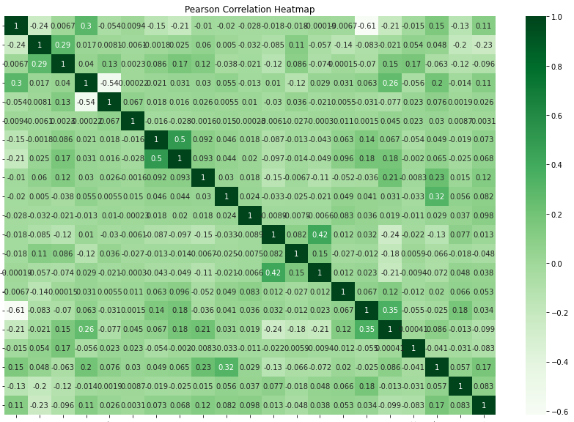
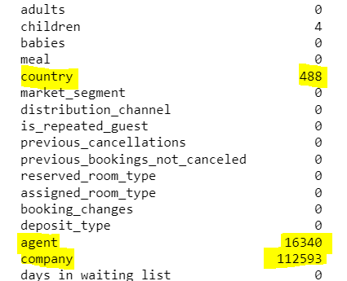
Data Exploration
Missing Values
Distribution (dist / hist plots)
Redundancy
Outliers and suspicious patterns
MLDM | Dafna Meron, Oriel Perets

Slide 15
Presentation Plan
Business Understanding
Data Understanding
Data Preparation
Modelling
Evaluation
Future Work
MLDM | Dafna Meron, Oriel Perets

Slide 16
Presentation Plan
Business Understanding
Data Understanding
Data Preparation
Modelling
Evaluation
Future Work
MLDM | Dafna Meron, Oriel Perets

Slide 17
Presentation Plan
Business Understanding
Data Understanding
Data Preparation
Modelling
Evaluation
Future Work
MLDM | Dafna Meron, Oriel Perets

Slide 18

Thank you!
MLDM | Dafna Meron, Oriel Perets

